Slide 1

Athira Karuvath Raj 100854112 Dheer Parikh 100919437
A case study on Netflix: Data-Driven Decision Making
Subject : Data Collection – DATA 1201 – 02
To: Dr. Amit Arora

Slide 2


Introduction*
Netflix and its value ($140B)
House of Cards as a pivotal moment
.

Slide 3
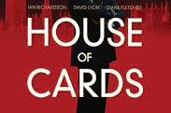
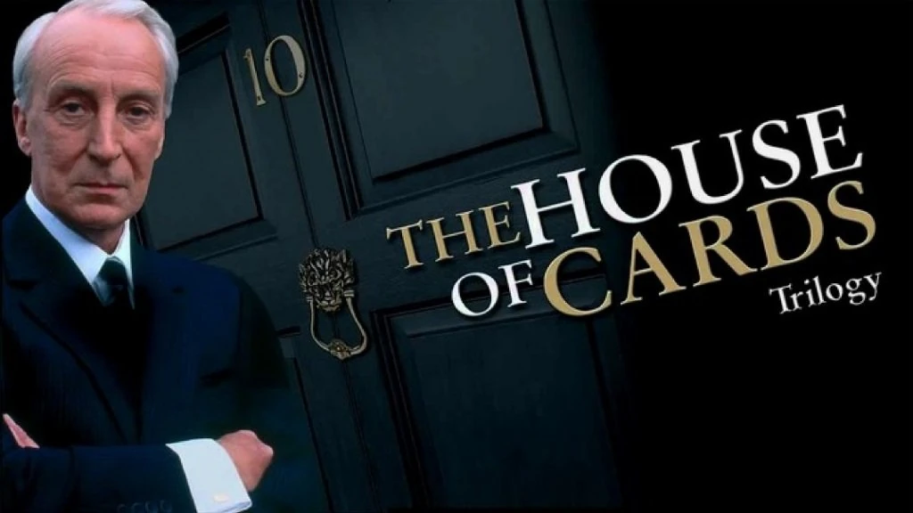
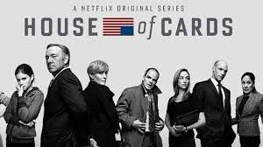
House of Cards
Netflix's $100M investment in House of Cards
Data-driven decision: Analyzed audience behavior
Correlation between UK House of Cards fans, Kevin Spacey movies, and David Fincher's work

Slide 4

Netflix's Data Philosophy
1. Accessibility, discovery, and processing of data for everyone
2. Importance of data visualization
3. Time sensitivity in data retrieval

Slide 5
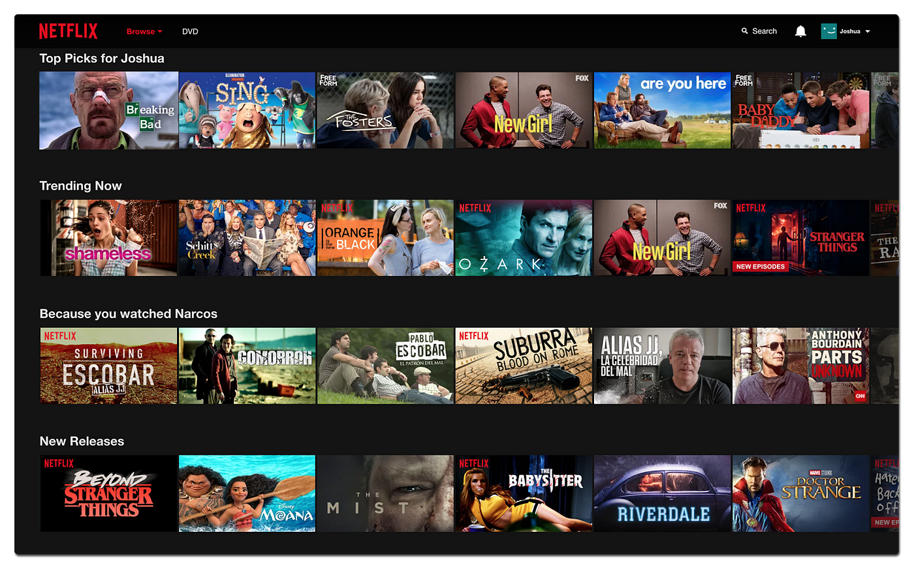
Personalization through Data Insights
Color breakdown in cover designs based on viewing habits
Advanced machine learning for recommendations
Informed decisions using comprehensive data

Slide 6

Experimentation and Testing
CEO Reed Hastings encourages experimentation
Emphasis on learning and hypothesis testing
Willingness to invest in large-scale experiments

Slide 7

Bright: Data-Driven Blockbuster
$90M investment in Bright
Marketing strategy based on customer data
11M viewers in the first 3 days despite poor reviews

Slide 8
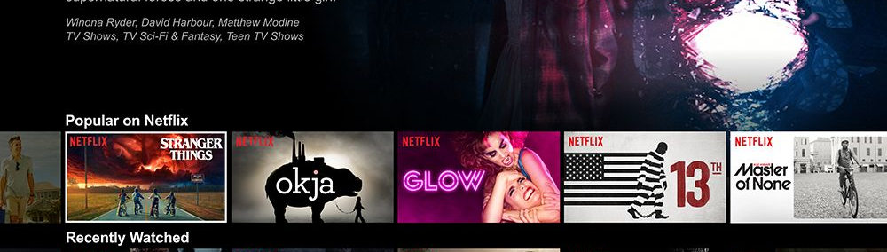
Continuous Marketing Lifecycle
Internal marketing algorithms for ongoing visibility
Contrasting with traditional box office premieres

Slide 9




Leveraging External Data for Marketing
Example of Gilmore Girls season launch
Viral response on social media as an indicator
Offline marketing tactics (Luke's Diner recreation)

Slide 10
Investing in Content and Marketing
Netflix's plan to increase marketing spending
Focus on content creation and marketing synergy
2018 projections: $8 billion on content, 700 TV shows, 80 films

Slide 11
References
1 https://outsideinsight.com/insights/data-drives-decision-making-netflix/
2 https://www.wired.com/insights/2014/03/big-data-lessons-netflix/
3 https://www.warc.com/newsandopinion/news/how_data_shapes_decisions_at_netflix/39341
4 https://www.cnbc.com/2018/01/09/success-of-bright-shows-even-netflixs-rotten-movies-are-blockbuster-hits.html
5 https://variety.com/2018/digital/news/netflix-700-original-series-2018-1202711940/

